Slide 1







SCALEFLOW ◀
ScaleFlow
Enterprise Project Intelligence Platform
Team 4
Shimaa Hubes
Sadeel Ardah
Saba abu Al-own
Mohammad Abdelfattah
Mostafa alnatshe
2026/2027

Slide 2
























PROJECT INTRODUCTION
02
Introducing ScaleFlow
Enterprise Project Intelligence Platform
About ScaleFlow
ScaleFlow is an intelligent project management platform that helps teams plan, monitor, and manage projects more efficiently using AI-powered insights.
Core Capabilities
Project and task management
AI-powered risk analysis
Delay prediction
Bottleneck detection
Project health analysis
AI-generated insights and recommendations
Target Users
Technology
Project Managers, Team Leaders, Team Members, and Clients
Flutter, ASP.NET Core (.NET 8), SQL Server, Python FastAPI, and Machine Learning

Slide 3

CHALLENGE
03
Problem Statement
Large and complex projects often face challenges that make effective management difficult.
KEY PROBLEMS
1
Tasks and responsibilities are fragmented across different tools and team members.
!
2
Dependencies between tasks are difficult to track.
MAIN CHALLENGE
3
Project managers may lack real-time visibility into project progress.
Teams need a centralized way to understand what is happening in their projects and identify potential problems before they become critical.
4
Risks and potential delays are often identified too late.
5
Creating progress reports is time-consuming and often manual.
6
Bottlenecks can remain hidden until they affect the project timeline.
Centralized visibility
Uneven workload distribution can reduce team efficiency.
Early problem detection
7

Slide 4
TRANSFORMATION
04
From Friction to Flow
Project Goals
Main Features
System Architecture
  Centralize project and task management in one platform.
  Improve visibility into project progress and team workload.
  Identify project risks, delays, and bottlenecks early.
  Use AI to transform project data into actionable insights.
  Reduce manual project monitoring and reporting.
  Project and task management
  Kanban and Gantt project tracking
  Task dependencies
  AI Risk Analysis
  AI Delay Prediction
  AI Bottleneck Detection
  AI Project Health Analysis
  AI-generated insights and recommendations
Flutter Mobile App
ASP.NET Core (.NET 8) Backend
SQL Server Database
Python FastAPI AI/ML Services
Role-Based Access Control for Project Manager, Team Leader, Team Member, and Client
Risk Model
Delay Model
Bottleneck Model
Health Model
Technology Stack
Team & Responsibilities
Project Management
Frontend
Flutter
Shimaa Habes
Team Leader, AI/ML, UI & Graphic Design, Flutter Development
ClickUp
Backend
ASP.NET Core / .NET 8
Sadeel Ardah
AI/ML
Database
SQL Server
ClickUp is used to organize the team workflow, assign tasks, track progress, manage deadlines, and document team work.
Saba abu Al-own
AI/ML
AI/ML
Python, FastAPI, Machine Learning
Mohammad Abdelfattah
Backend .NET Development
AI Services
Risk Analysis, Delay Prediction, Bottleneck Detection, Project Health
Mostafa alnatshe
Backend .NET, Security Testing, Authentication & Authorization
NEXT Live Demo Roadmap
We will now demonstrate the main ScaleFlow workflow from project creation to AI-powered project insights.

Slide 5
SCALEFLOW ◇
Mohammad
Backend Track
System Architecture · Database Modeling · Business Logic
Notes:
Introduce yourself: AI/ML track. Three tasks: define the data, prepare the data, train and evaluate the first baseline models.
1

Slide 6








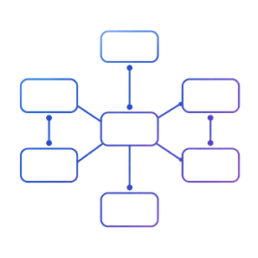

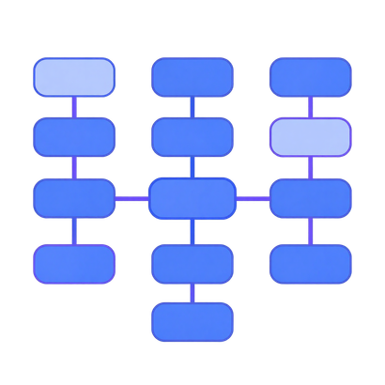
SCALEFLOW
Backend Architecture & Database Foundation
Establishing a robust, scalable, and structured core for ScaleFlow
Project Architecture
Complex ERD Design
Domain Models
Data Integrity
Organized layers, BaseEntity, EF Core, and FluentValidation configurations.
Engineered schema (36 tables, 62 FKs) supporting complex task relationships.
Mapped DB design to C# models with precise Many-to-Many relations & Enums.
Implemented soft deletion, status tracking, and robust error handling.
Established a highly scalable database foundation and clean project architecture.

Slide 7
ScaleFlow
Core APIs & Advanced Business Logic
API Request
Input Validation
Delivering secure endpoints with intelligent task and workload management
Privacy Check
Task Engine
DB Execution
01
Core CRUD APIs
02
Task Engine
03
AI & ML Integration
04
Automated Testing
Built unified ApiResponse, DTOs, and resource-level privacy checks.
Developed algorithmic prevention of invalid and circular task dependencies.
Developed APIs integrating external ML models for project delay prediction, risk analysis, and bottleneck detection
Executed 71+ tests covering AI integrations, real-time notifications, workload tracking, reporting, and secure core APIs
✓
Delivered secure, rigorously tested APIs powering advanced project management capabilities.

Slide 8
Real-Time Systems & AI Infrastructure
Empowering ScaleFlow with instant updates and AI integration bridges
AI Report Generation
AI Integration API (JSON)
Database Storage
Notifications Engine Trigger
SignalR Live Broadcasting
Real-Time SignalR
AI/ML Infrastructure
AI Integration API
Notifications Engine
WebSockets broadcasting for instant UI updates via authenticated ScaleFlowHub.
Prepared tables and logic for project health, risk, and delay predictions.
Built endpoints to receive and store AI-generated reports as structured JSON.
Centralized endpoints for fetching system events and AI-triggered alerts.
Transformed ScaleFlow into a live, reactive platform fully prepared for AI integration.

Slide 9

SCALEFLOW ◇
Mostafa
Backend Track
Authentication & RBAC · API Security · Security Testing

Slide 10



























SCALEFLOW
Register
AUTHENTICATION
  Valid & invalid registration
  Correct & incorrect login
  Password hashing & validation
Authentication
& RBAC
Login
JWT
JWT
JWT
  JWT generation
  Token validation
  Token expiration testing
JWT
Complete, secure, and verify the authentication flow
RBAC
  ProjectManager
  TeamLeader
  TeamMember
  Client
Role Claims
AUTHORIZATION
Protected API
  Protected [Authorize] endpoints
  Role-based access
  Verified 200 / 401 / 403
Authentication and role-based access flow verified and ready for protected API integration.

Slide 11































SCALEFLOW
Securing Core Project & Task APIs
Applying JWT authentication and RBAC to core resources
JWT Authentication
ACCESS BOUNDARIES
JWT PROTECTION
Users can only access resources within their permitted:
Protected Project and Task endpoints using JWT.
Role Validation
  Organization
  Project
  Membership scope
Organization Boundary
ROLE-BASED ACCESS
Applied permissions for:
SECURITY VERIFICATION
  ProjectManager
  TeamLeader
  TeamMember
  Client
Project / Membership Check
Verified:
200 OK
401 Unauthorized
403 Forbidden
Protected Project & Task APIs
Project and Task access is controlled by authentication, role, organization, and membership boundaries.

Slide 12


























SCALEFLOW
Final API Security & Review
Securing Dependency, Team/Member APIs and validating the complete backend
DEPENDENCY & TEAM APIS
RESOURCE PROTECTION
FINAL SECURITY TESTING
JWT authentication
Verify users cannot:
Tested:
RBAC for all four roles
View unauthorized resources
Valid JWT
Create unauthorized resources
Invalid JWT
Project ownership checks
Expired JWT
Team membership validation
Update unauthorized resources
JWT claims
Delete unauthorized resources
Role permissions
Organization isolation
Protected endpoints
Access is restricted by:
200 OK
Role + Organization + Ownership + Membership
401 Unauthorized
403 Forbidden
Final security review completed before Flutter integration.

Slide 13
SCALEFLOW ◇
Sadeel
AI / ML Track
Data Requirements · Data Preparation · Baseline Models
Notes:
Introduce yourself: AI/ML track. Three tasks: define the data, prepare the data, train and evaluate the first baseline models.
1

Slide 14







SCALEFLOW ◇
TASK 01 · DATA FOUNDATION
Defining AI/ML Data Requirements
What ScaleFlow must collect to predict delays and risk
Task Delay Prediction
Risk Analysis
Target: is_delayed (0/1)
Target: risk_level (Low/Med/High)
Task
Dependencies
Workload
Project
History
status, priority, dates
blocked / delayed links
assigned vs available hours
overdue & blocked tasks
timestamped snapshots
Prototype dataset: Apache JIRA (8.78 GB, real software projects)
Strong
task metadata · history · dependencies
Partial
duration (no due date)
Gap
workload hours · progress % · risk label
Gaps are not invented → resolution time is used as an honest prototype target.
Notes:
Define the data before modelling. MVP = delay + risk. Five data groups. Leakage rule. JIRA for prototype; gaps documented, not invented.
2

Slide 15
SCALEFLOW ◇
TASK 02 · DATA PREPARATION
Preparing the ML Dataset
Raw Apache JIRA → clean, leakage-safe, time-based splits
9M+
1,121,625
841,248
643
changelog rows processed
clean issues (8,216 duplicates removed)
leakage-safe model rows
numeric features (one-hot, train-only)
Chronological split — past trains, future tests
Train 588,873
2000 → Apr 2018
Val 126,187
→ Feb 2021
Test 126,188
→ Nov 2024
Regression
Classification
Isolation Forest
Target: resolution_time_days
Data: train / val / test
Target: long_resolution_risk ≥ 143.23 d
Data: train / val / test
Target: no target
Data: bottleneck_dataset · 938,948 rows
Notes:
Chunks of 100K rows. Cleaning, link and changelog features, left join. Only 7 creation-time features; issues whose priority/type/project changed were removed → 841,248 rows. Time split 70/15/15. Threshold and categories from training only. Separate unsupervised bottleneck dataset. All checks passed.
3

Slide 16
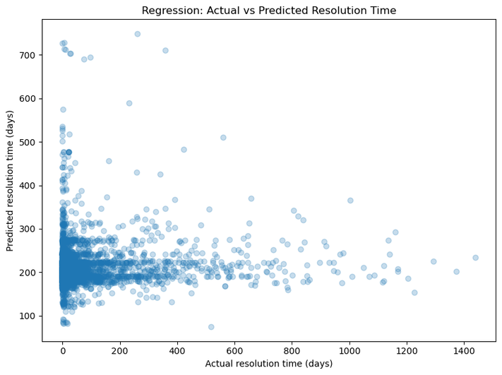
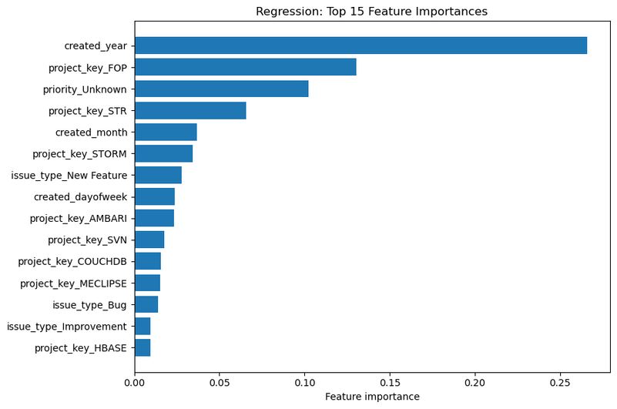
SCALEFLOW ◇
TASK 03 · BASELINE RESULTS
Result 1 — Resolution Time
Regression · Random Forest Regressor · 588,873 training issues · test = 2021–2024
190.8
Test MAE (days)
209.9
Test RMSE (days)
−1.27
Test R²
Model predicts ~150–300 days for almost every issue
created_year is the top feature (26.6%)
Notes:
Regression results: MAE = average error in days, R² negative = worse than always predicting the mean. Scatter shows predictions stuck around 200 days. Feature importance: created_year dominates.
4

Slide 17
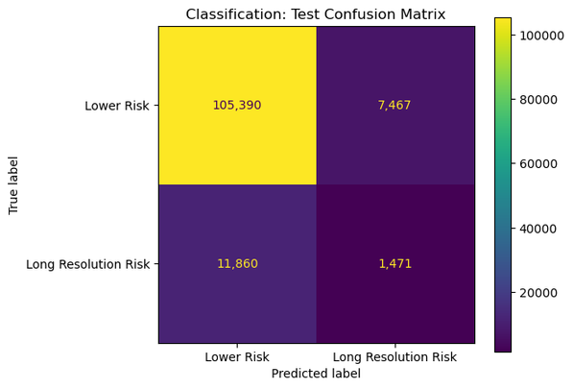
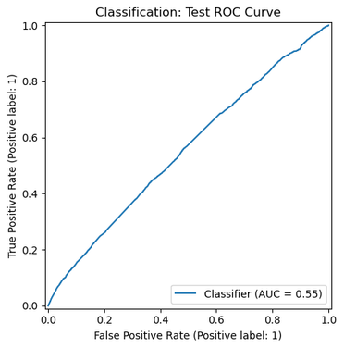
SCALEFLOW ◇
TASK 03 · BASELINE RESULTS
Result 2 — Long-Resolution Risk
Classification · Random Forest · class_weight = balanced · threshold 143.23 days
Split | Accuracy | Precision | Recall | F1 | AUC
Validation | 0.800 | 0.268 | 0.115 | 0.161 | 0.584
Test | 0.847 | 0.165 | 0.110 | 0.132 | 0.554
Why accuracy 0.85 is misleading
Only 10.6% of test issues are long. Predicting "not long" for every issue already gives ~0.89 accuracy.
F1 = 0.13 and AUC = 0.55 (≈ random ranking) show the real performance.
Notes:
Precision = of flagged, how many were really long. Recall = of real long, how many caught. Accuracy misleading due to imbalance. Confusion matrix and ROC from the notebook.
5

Slide 18
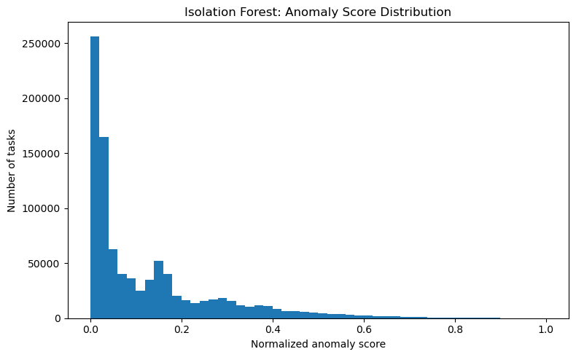
SCALEFLOW ◇
TASK 03 · BASELINE RESULTS
Result 3 — Potential Bottlenecks
Isolation Forest · 200 trees · contamination = auto · unsupervised
938,948
94,578
resolved tasks scored
potential bottlenecks
10.07%
10
flagged rate
lifecycle features
Task | Project | Score
OAK-7182 | OAK | 1.000
BEAM-2530 | BEAM | 0.999
ZOOKEEPER-107 | ZOOKEEPER | 0.998
IGNITE-2703 | IGNITE | 0.997
MNG-624 | MNG | 0.991
Notes:
Isolation Forest isolates unusual rows faster. Scored 938,948 resolved tasks, flagged 94,578 (10.07%). Top flagged tasks listed. Needs manual validation.
6

Slide 19
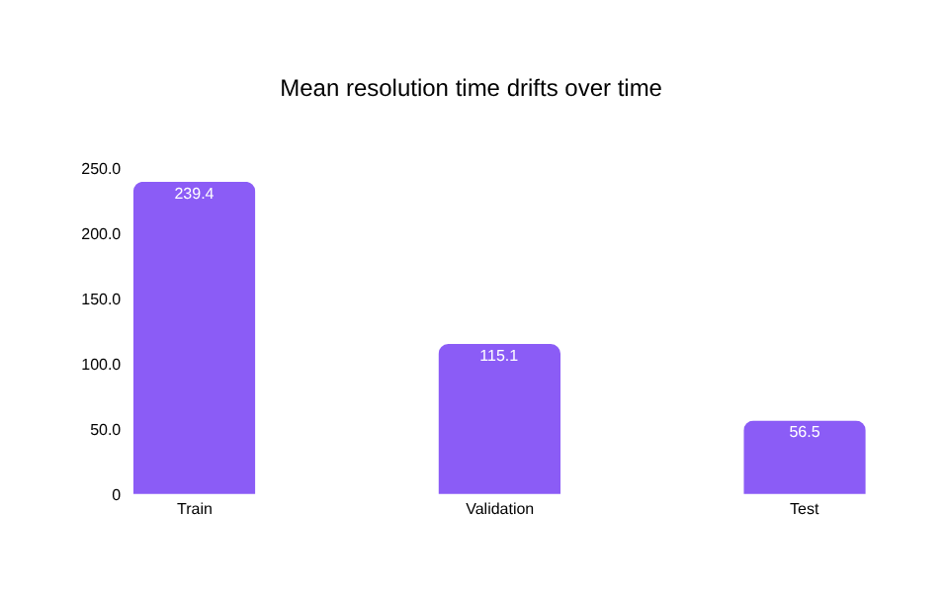




SCALEFLOW ◇
TASK 03 · FINDINGS
What the Results Tell Us
Why the supervised baselines are weak
Little info at creation
Distribution shift
Only 7 features — no text, assignee, workload or dependencies.
Mean resolution 239 d (train) → 56 d (test).
Right-censoring
No extrapolation
Recent long issues are still open, so missing from test.
created_year can’t generalise to unseen years.
Notes:
Honest baseline. Four reasons. The pipeline works and proves the Task 1 data is essential. Next steps.
7

Slide 20

SCALEFLOW ◇
Saba
AI / ML Track
ML models · evaluation · AI analysis
Notes:
Introduce yourself: AI/ML track. Three tasks: define the data, prepare the data, train and evaluate the first baseline models.
1

Slide 21




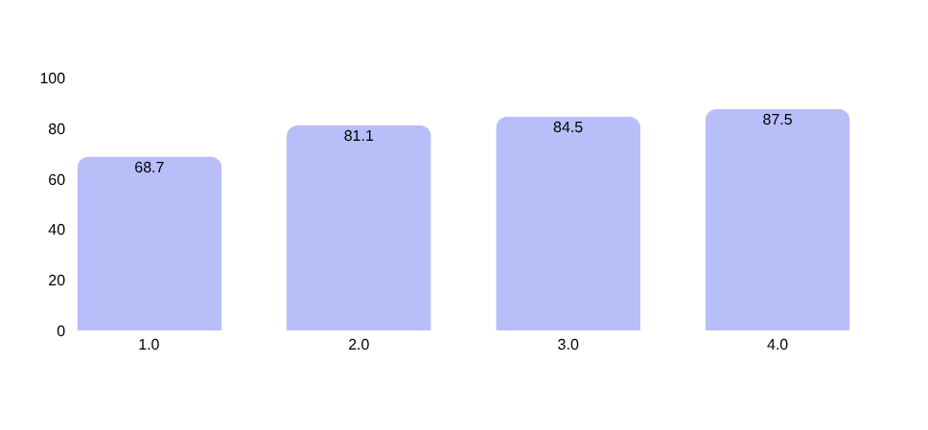

SCALEFLOW ◇
TASK 01 · DATA PREPARATION
Preparing the Jira Ticket Data
From raw tickets to a model-ready dataset
1,192
18
953 / 239
3 classes
clean tickets (from 1,193 raw)
model features
train / validation / test, 80/20/20 stratified
Fast ≤30d · Medium · Slow >365d
Cleaning & target
CV accuracy by feature group
  Masked URLs, IPs, hashes and numbers in text
  Truncated long descriptions to 3,000 characters
  Dropped duplicates, invalid dates and 1 pre-2019 outlier
  Target = Resolved − Created, cut at 30 / 365 days
Key rule: majority-class baseline is 57.4% — every model must beat it.
Notes:
1

Slide 22
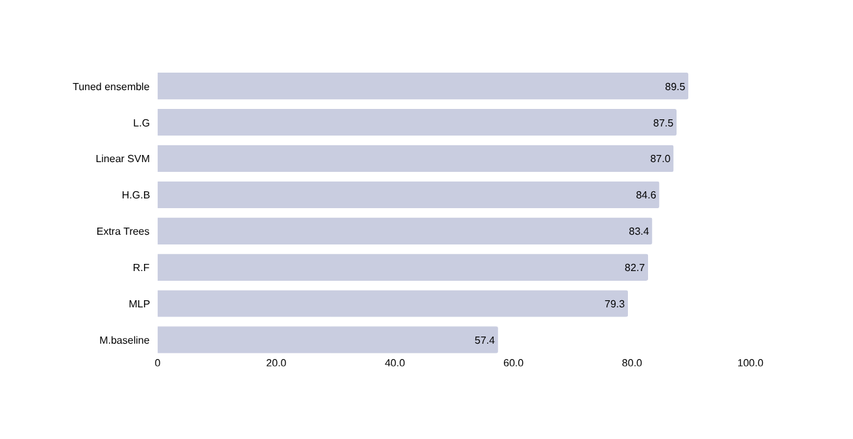


SCALEFLOW ◇
TASK 02 · BASELINE MODELS
Resolution-Time Prediction
Fast / Medium / Slow classification on Jira tickets
Cross-validated accuracy (%)
88.7%
Test accuracy
83.6%
macro F1
0.953
ROC-AUC
Result: +31 points over the 57.3% baseline; 99.6% of predictions within one class.
Notes:
2

Slide 23








SCALEFLOW ◇
TASK 03 · BOTTLENECK DETECTION
Detecting Bottleneck Issues
Unsupervised Isolation Forest — no labeled bottlenecks exist
Time & Duration
Process Friction
Dependencies
Collaboration
Rework & Status
6 features
6 features
6 features
4 features
4 features
cycle time, age, worklogs
reassignments, reopens
blocking / blocked-by, links
comments, work sessions
rework, long-running, stale
26 features
300 trees
10 columns excluded
Curated across 5 groups; median-imputed and standardized
Isolation Forest · contamination 5% · fixed seed 42
Pre-computed risk scores removed to avoid leakage
Output: bottleneck_score + is_bottleneck flag per issue, with a top-50 shortlist for review.
Notes:
3

Slide 24
SCALEFLOW ◇
Shimaa
AI / ML Track
ML models · evaluation · AI analysis
Notes:
Introduce yourself: AI/ML track. Three tasks: define the data, prepare the data, train and evaluate the first baseline models.
1

Slide 25
AI MODELS
AI Models — Risk & Project Health
Risk Model
Project Health Model
Results
DATASET
INPUTS
RISK MODEL
4,000 real-world-style project risk records with 49 features
project progress
tasks
Produces a project-specific risk score and risk level based on project data
planned/actual hours
team activity
TARGET
Low
Medium
High
Critical
workload-related features
PROJECT HEALTH MODEL · EXAMPLE RESULT
MODEL
OUTPUT
83.15
Healthy
16.85%
Logistic Regression with preprocessing and class balancing
Health Score (0–100)
Health Status
Health Score
Health Status
Failure Probability
Failure Probability
OUTPUT
Risk Level
Risk Score (0–100)
Confidence
Integrated with the ScaleFlow backend for project-specific risk analysis
Integrated with ScaleFlow to evaluate the current health of each project
Both models are connected to the ScaleFlow AI Insights workflow and can analyze individual projects through the backend
KEY OUTCOME
AI models transform project data into measurable indicators that help teams understand project risk and overall project health.

Slide 26
Thanks

